Slide 1

Is The Long Waiting Time in Pharmacies Caused By Lack Of Manpower?
Randal Hong
DAAA/FT/1B/03

Slide 2
Datasets Used In The Analysis
Number of Graduates in Healthcare Specialisation: https://beta.data.gov.sg/collections/492/view
Number of Pharmacists: https://beta.data.gov.sg/collections/497/view
ITE Intakes, Enrolments and Graduates: https://beta.data.gov.sg/collections/416/view
Polytechnics Intakes, Enrolments and Graduates: https://beta.data.gov.sg/collections/440/view
Universities Intakes, Enrolments and Graduates: https://beta.data.gov.sg/collections/443/view
Graduate Employment Survey: https://beta.data.gov.sg/collections/415/view

Slide 3
Background Overview Of The Topic
As we are concerned about the waiting time only in the pharmacy, we will mainly be focusing on the manpower in the pharmacy (number of pharmacists)
Note that the waiting time to consult the doctor is not our main focus; our main focus is the time taken to get the medicine after consulting the doctor as that usually takes longer

Slide 4
Insight 1: Checking the Ratio Between Number of Doctors and Pharmacists
Having more doctors that pharmacists may suggest that patients are able to complete the doctor’s consultation faster than receiving their medication
This will result in a longer waiting time in the pharmacy

Slide 5
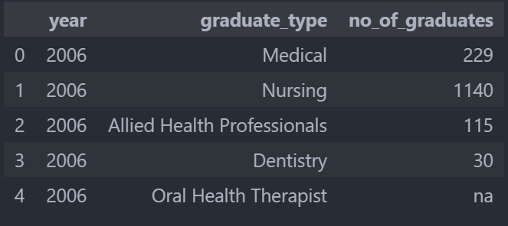
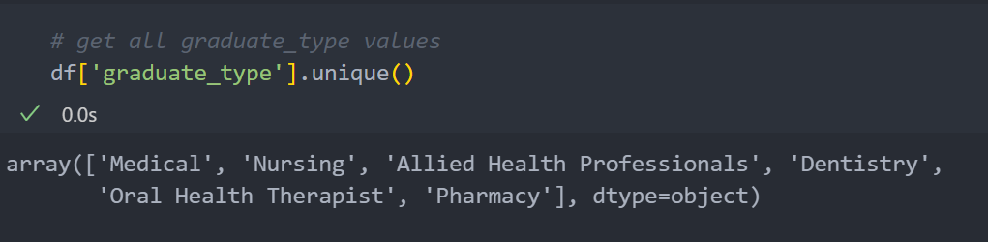
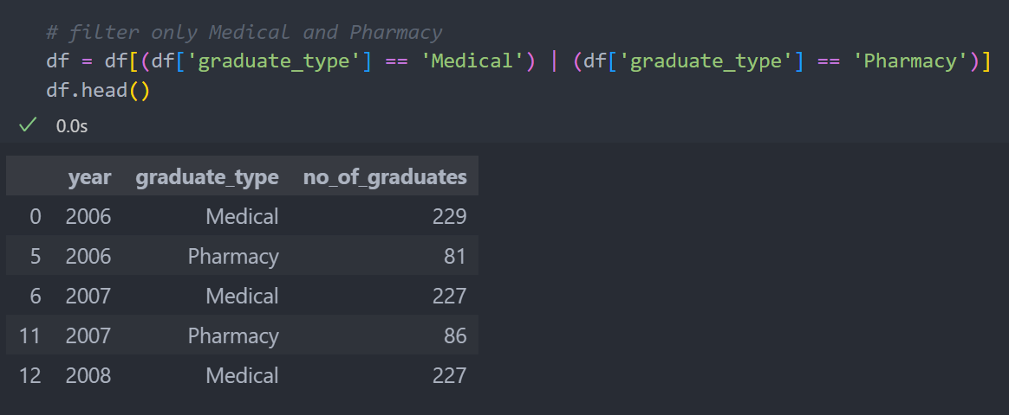
Insight 1: Checking the Ratio Between Number of Doctors and Pharmacists
For the Number of Graduates in Healthcare Specialisations by Course dataset, it has several graduate_types which we can view them by using pd.unique()
However, as we are only concerned with doctors and pharmacists, we will only filter out medical and pharmacy graduates

Slide 6
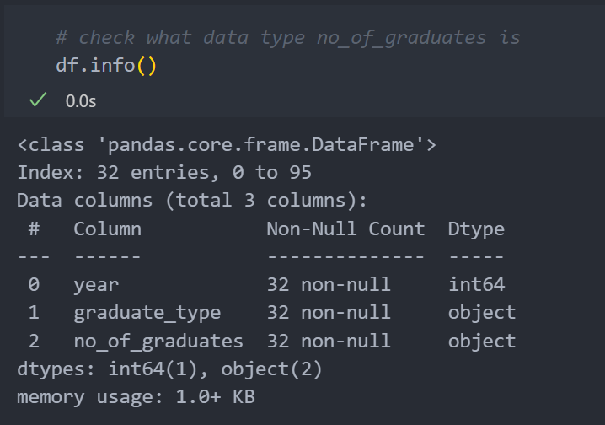
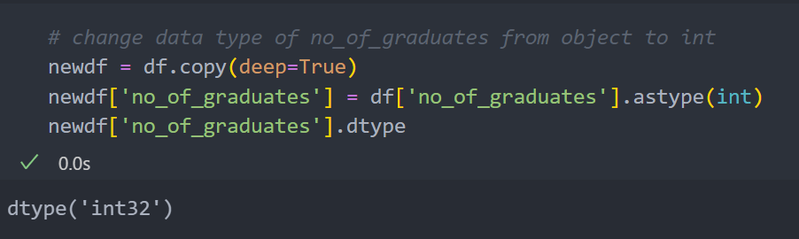
Insight 1: Checking the Ratio Between Number of Doctors and Pharmacists
We can view the datatype of each column by using pd.info()
As there were some errors in plotting the graph using the object type, we had to convert the datatype to an integer with pd.astype(int)

Slide 7
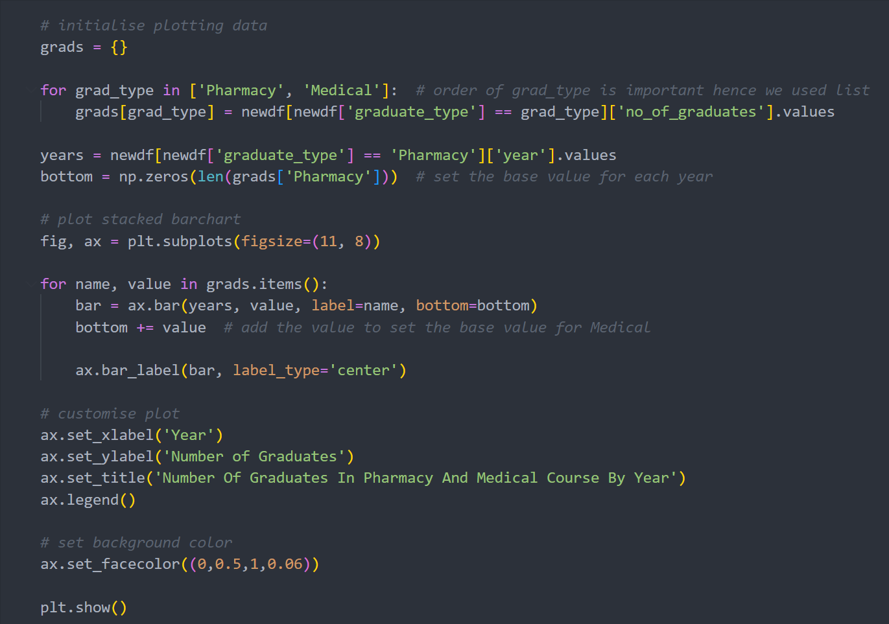
Insight 1: Checking the Ratio Between Number of Doctors and Pharmacists
For this insight, we plotted a stacked bar graph using ax.bar() to compare the number of graduates in pharmacy and medical course by year
We also added a text for each bar plot to indicate the number of graduates for the respective bar plot using ax.bar_label()

Slide 8
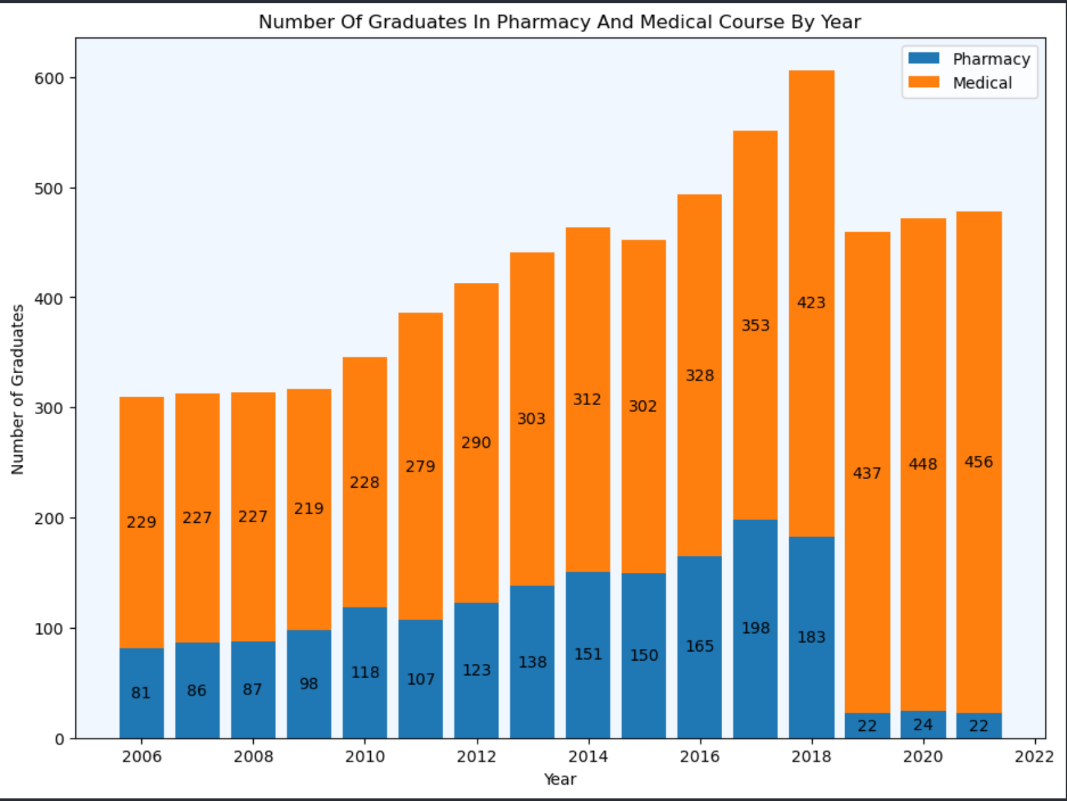
Insight 1: Checking the Ratio Between Number of Doctors and Pharmacists
As we can see from the graph, other than from 2019 to 2021, there are generally about 2 times as many medical graduates as pharmacy graduates
This suggests that each pharmacist will have to handle 2 times the number of patients that the doctor handles
Thus, this may result in a longer waiting time in the pharmacy as patients are quickly diagnosed by the doctor but have to wait a longer time for the medicine to be dispensed to them

Slide 9
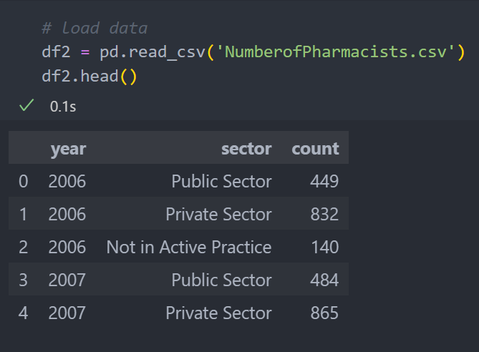
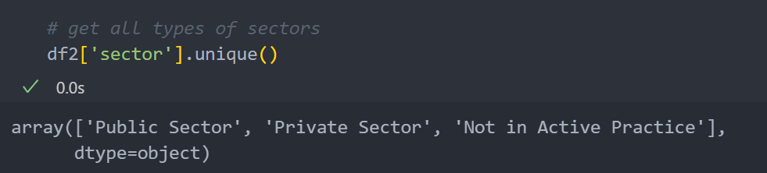
Insight 2: Checking The Number of Pharmacists in Each Sector
For the Number of Pharmacists dataset, it has 3 types of sectors, Public, Private and Not in Active Practice which we can view by using pd.unique()
Example of public sectors will be Tan Tock Seng Hospital which are more cheaper but have more waiting time
Example of private sectors will be Farrer Park Hospital which are more expensive but have less waiting time
Not in Active Practice suggests pharmacists that are not currently working

Slide 10
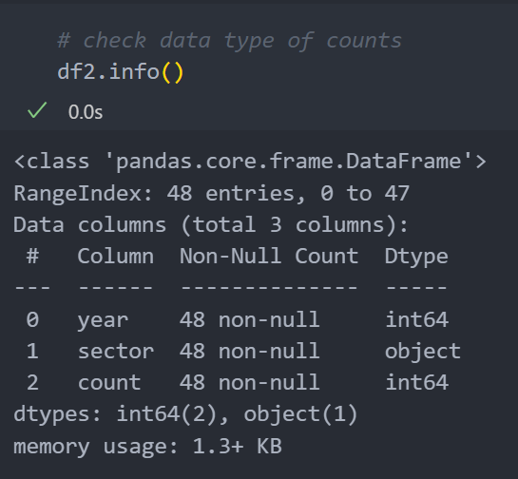
Insight 2: Checking The Number of Pharmacists in Each Sector
We can view the datatype for each column by using pd.info()
As the count column is an integer, we do not need to change its datatype

Slide 11
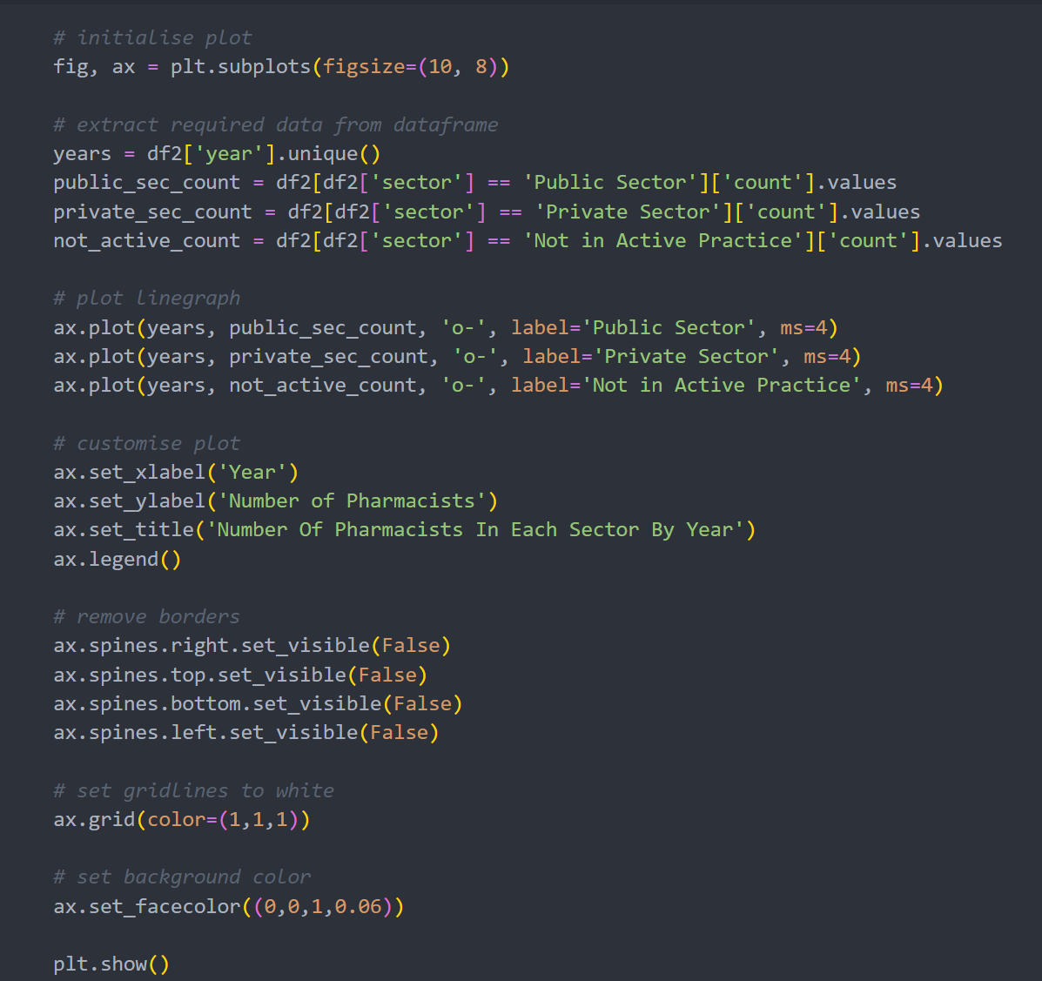
Insight 2: Checking The Number of Pharmacists in Each Sector
For this insight, we plotted a line graph to see the trend of the number of pharmacists in each sector by year (whether they are increasing or not) using ax.plot()

Slide 12
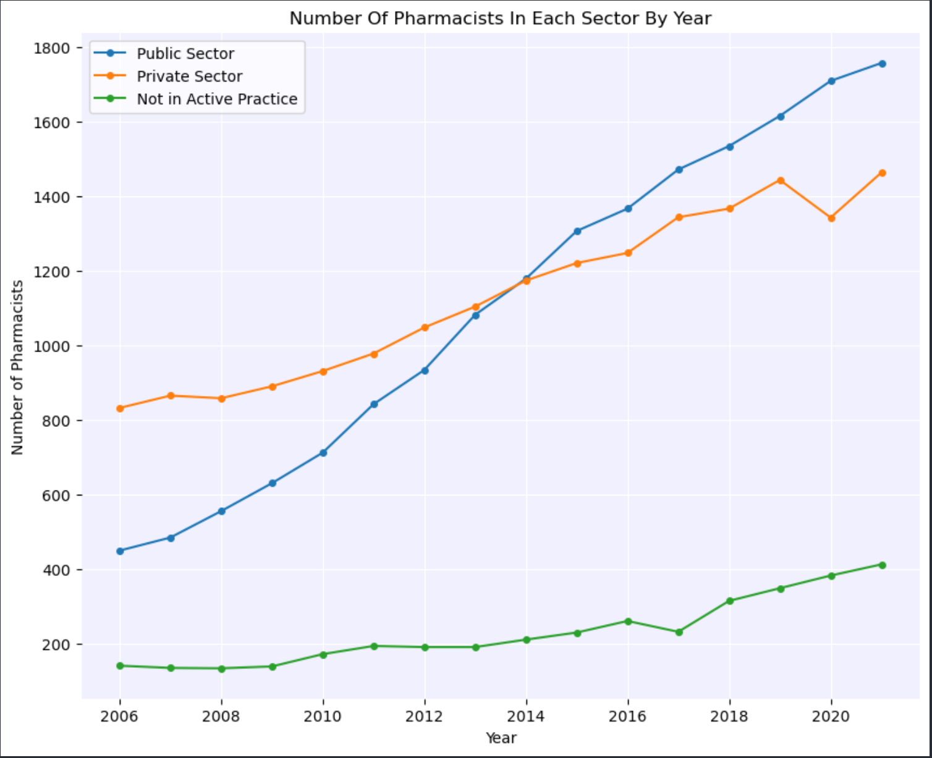
Insight 2: Checking The Number of Pharmacists in Each Sector
From the graph, we can see that generally the number of pharmacists increases over the years
At first, the number of pharmacists in the private sector were more than the number of pharmacists in the public sector
However, the number of pharmacists in the public sector surpassed the private sector starting from around after 2013 and more pharmacists work in the public sector than in the private sector

Slide 13
Insight 2: Checking The Number of Pharmacists in Each Sector
However, we cannot conclude that there is more relative manpower in the public sector than in the private sector as majority of the patients will go to public sectors are they are much cheaper
As the difference between the number of pharmacists in the public and private sector is not a huge difference, I do think that there is still a lack of manpower in the public sector, hence resulting in a longer waiting time

Slide 14
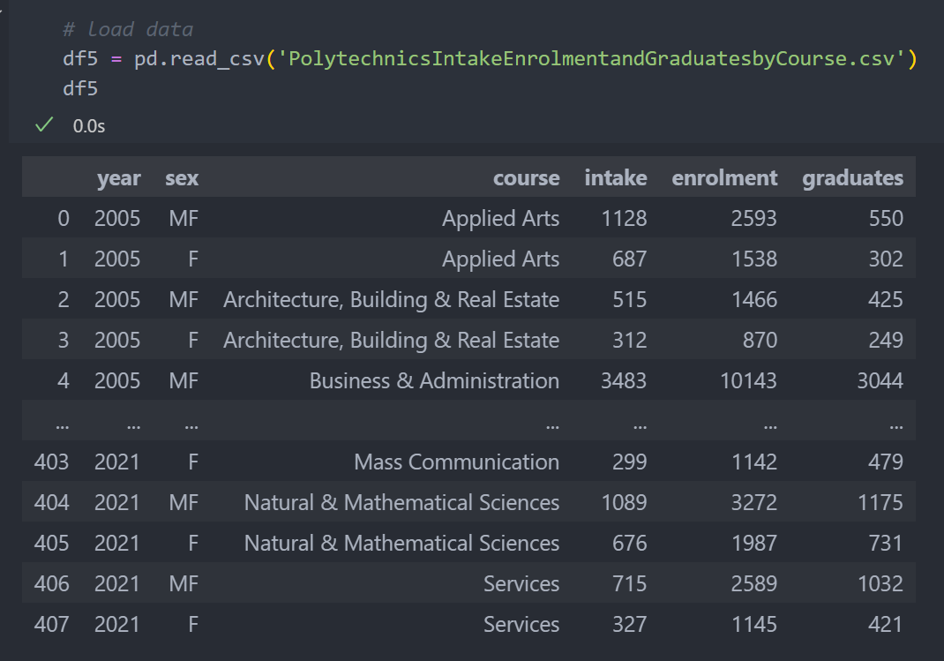
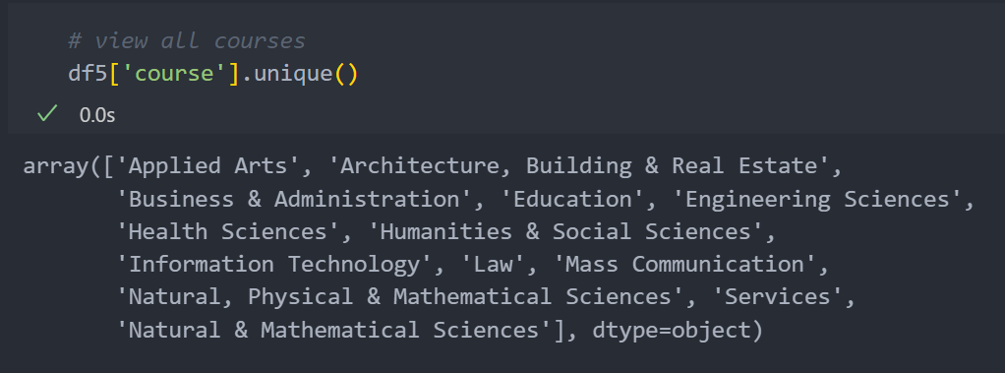
Insight 3: Checking The Number Of Health Science Polytechnic Graduates
For the Polytechnics Intake Enrolment and Graduates By Course dataset, we can see all the intakes, enrolments and graduates of all the polytechnics in Singapore for each course by using pd.unique()

Slide 15
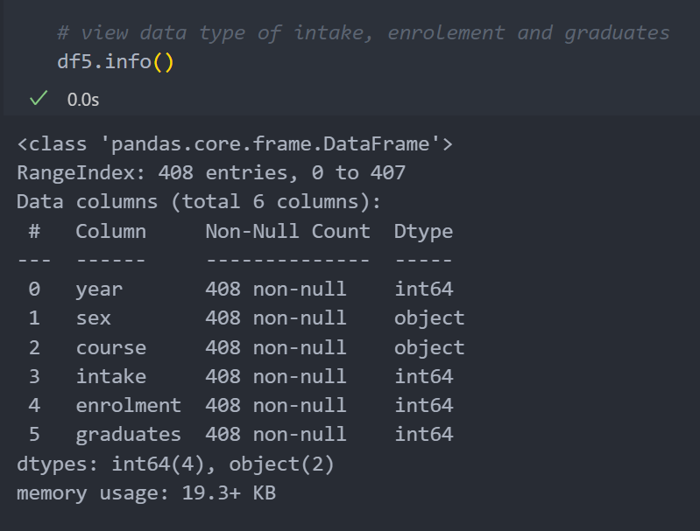
Insight 3: Checking The Number Of Health Science Polytechnic Graduates
We can view the datatype for each column using pd.info()
As the datatype for the intake, enrolment and graduate column is an integer, we do not need to change its datatype

Slide 16
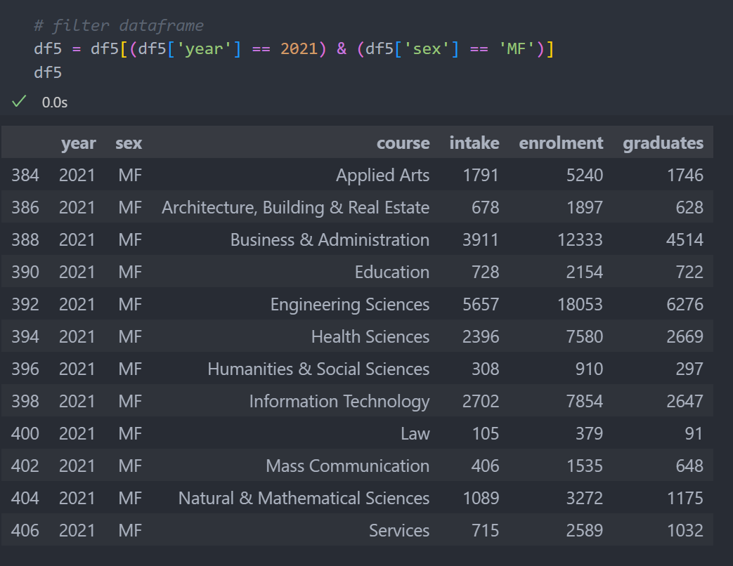
Insight 3: Checking The Number Of Health Science Polytechnic Graduates
For the sex column, MF mean both males and females
As we want the total number of intakes, enrolments and graduates, we will filter the dataframe with rows only including MF
For this insight, we will use the latest data which is from 2021

Slide 17
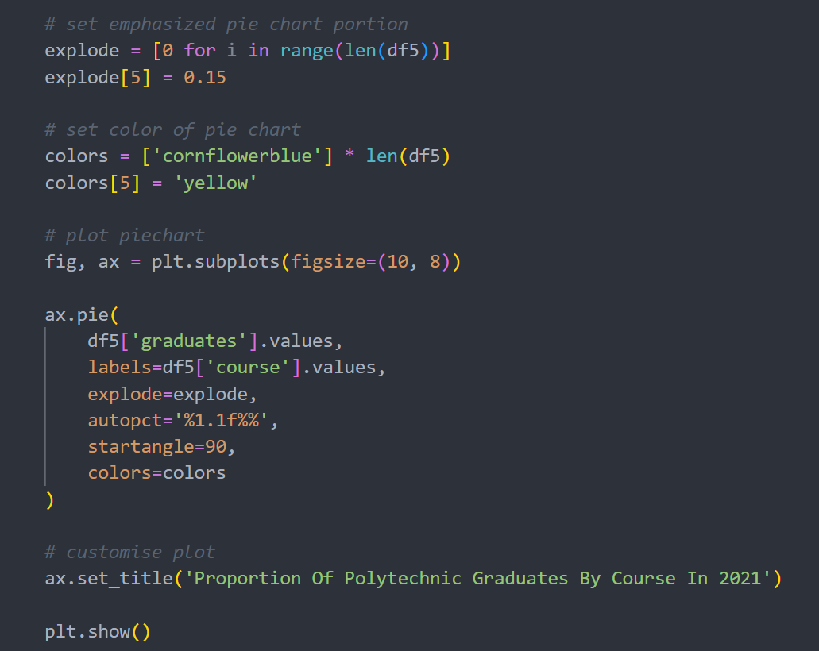
Insight 3: Checking The Number Of Health Science Polytechnic Graduates
For this insight, we plotted a pie chart to see the proportion of Health Science graduates using ax.pie()
We created an array of zeroes and changed the 6th element to 0.15 to explode the pie for Health Sciences as it is the 6th column in the dataset
We did the same for the colors by making a list of the same colors for the other pies except for Health Sciences and changed it to yellow

Slide 18
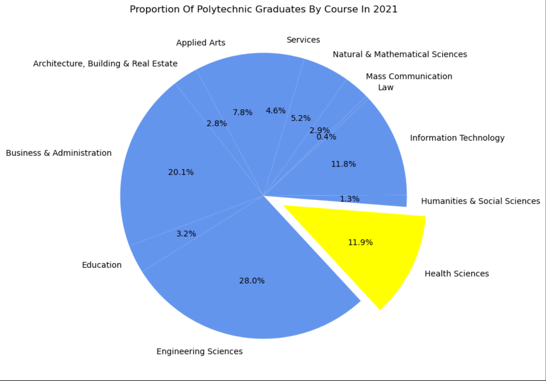
Insight 3: Checking The Number Of Health Science Polytechnic Graduates
From the chart, we can see that 11.9% of all the polytechnic graduates study Health Sciences, which is about 1 in 10 graduates
Although this may not seem little, as Health Sciences is a broad field of study (includes Dentistry, Nursing etc) and not all of the Health Sciences graduates will go to pharmacy, I can conclude that there are not much people studying to become a pharmacist

Slide 19
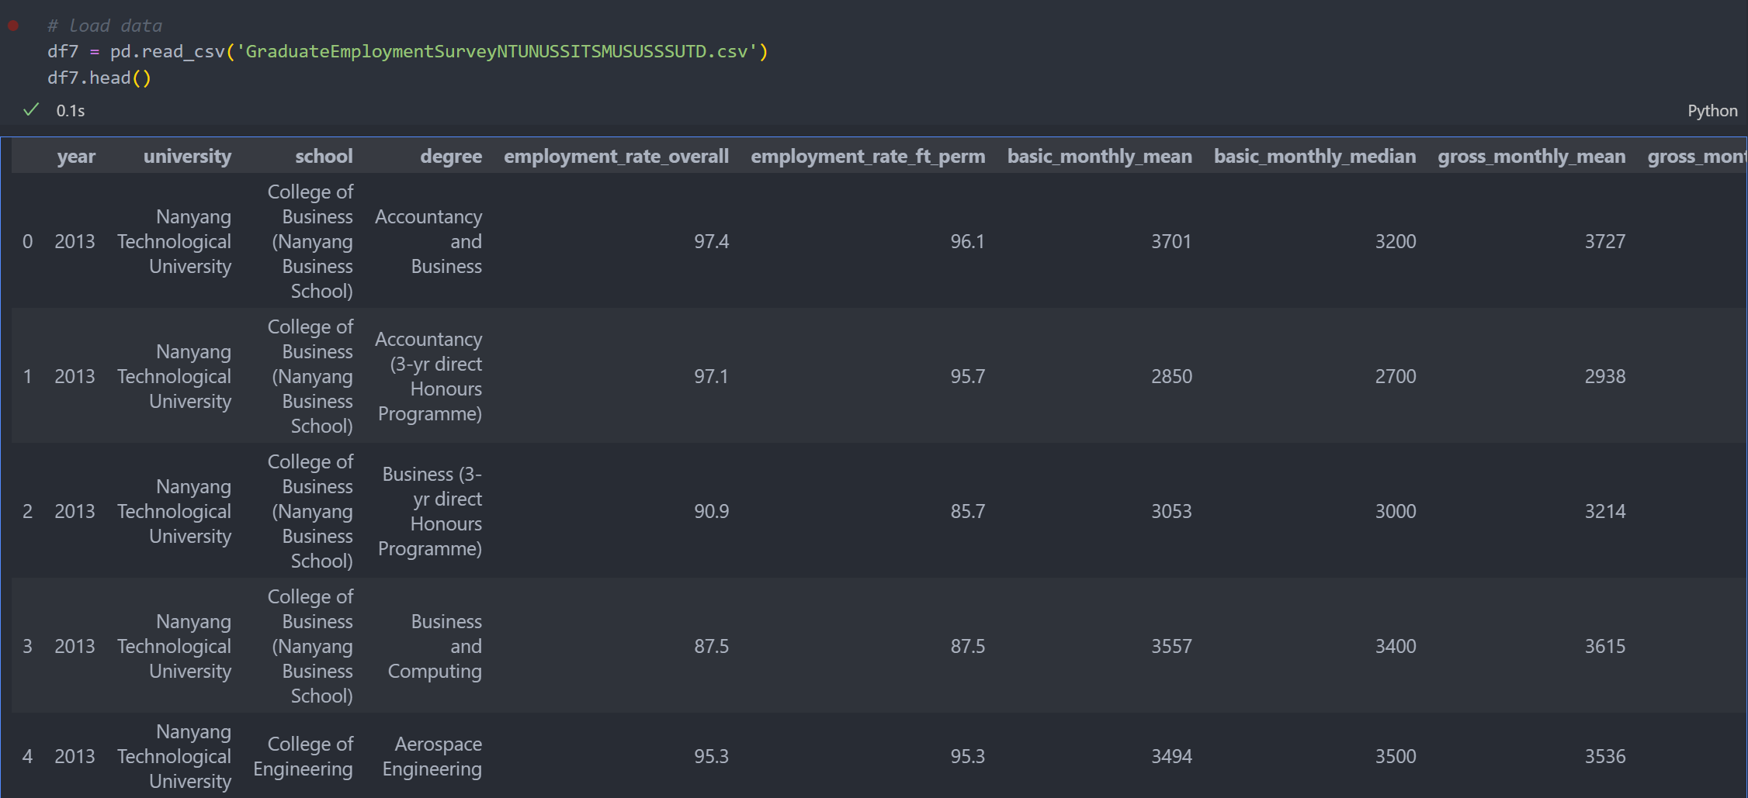
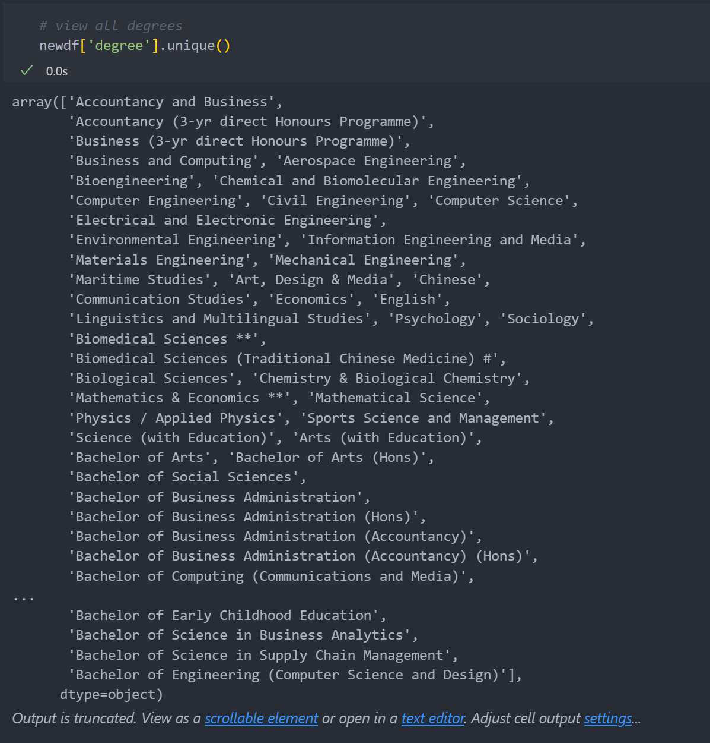
Insight 4: Checking The Pay of Pharmacy Graduates
For the Graduate Employment Survey NTU NUS SIT SMU SUSS SUTD dataset, we can see the salary of each degree from each school by using pd.unique()

Slide 20
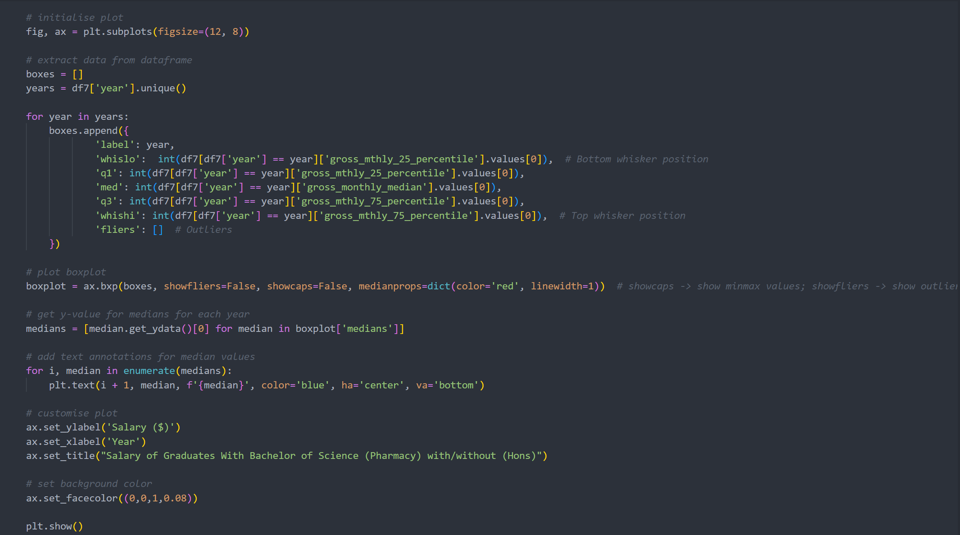
Insight 4: Checking The Pay of Pharmacy Graduates
For this insight, we plotted a boxplot of the salary of graduates with Bachelor of Science (Pharmacy) with/without (Hons) using ax.bxp()

Slide 21
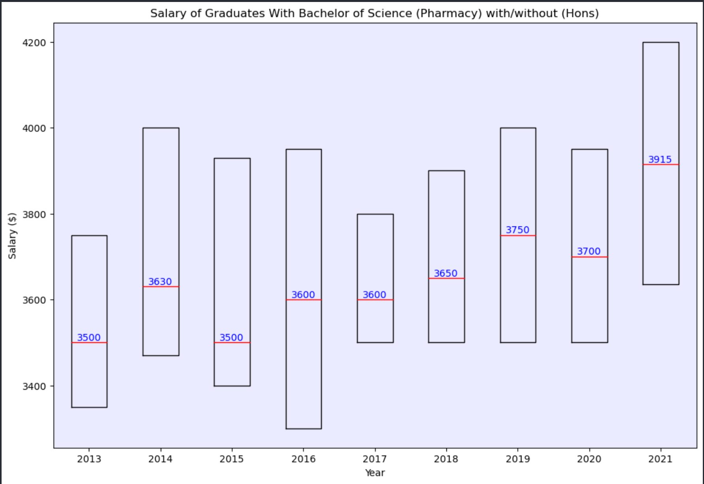
Insight 4: Checking The Pay of Pharmacy Graduates
From the graph, we can see that although the salary of the graduates have been increasing over the years, it is not a lot compared to degrees such as computer science, for example
This may suggest that the job pay may not attract many people to do pharmacy and thus there is a shortage of manpower in the pharmacy, leading to longer waiting times

